Slide 1
C.I.Manoranjan
Final Project
3/21/2024 Annual Review

Slide 2
PROJECT TITLE
Natural Language Processing
3/21/2024 Annual Review

Slide 3


AGENDA
PROBLEM STATEMENT
PROJECT OVERVIEW
WHO ARE THE END USERS
YOUR SOLUTION AND ITS VALUE PROPOSITION
THE WOW IN YOUR SOLUTION
MODELING
RESULTS
3/21/2024 Annual Review

Slide 4

PROBLEM STATEMENT
Despite the increasing availability of textual data, many individuals and organizations struggle to derive meaningful insights from it. This presentation aims to address this challenge by demonstrating how natural language processing (NLP) techniques can be applied using Python libraries. We'll explore sentiment analysis, tokenization, stop words removal, and visualization methods to uncover valuable insights from textual data.
3/21/2024 Annual Review

Slide 5

PROJECT OVERVIEW
This project aims to tackle the challenges associated with analyzing textual data by leveraging natural language processing (NLP) techniques in Python. By implementing sentiment analysis, tokenization, stop words removal, and visualization methods, we aim to provide a comprehensive solution for extracting meaningful insights from textual data efficiently and effectively.
3/21/2024 Annual Review

Slide 6

WHO ARE THE END USERS?
Business Analysts: Analyzing customer feedback and reviews to gain insights into sentiment and preferences.
Marketing Teams: Understanding consumer behavior, brand perception, and market trends.
Customer Support Representatives: Prioritizing and categorizing customer feedback to improve response strategies.
Product Managers: Identifying feature requests, user requirements, and areas of product satisfaction or dissatisfaction.
Researchers: Studying language patterns, sentiment dynamics, and social trends.
Executives and Decision Makers: Utilizing concise summaries and actionable insights to inform strategic decisions.
Data Scientists and Analysts: Conducting advanced NLP analyses, developing models, and optimizing algorithms for various applications.
3/21/2024 Annual Review

Slide 7

YOUR SOLUTION AND ITS VALUE PROPOSITION Efficiency: Automates sentiment analysis and text processing tasks, saving time and resources compared to manual methods. Insightful Visualizations: Generates intuitive visualizations such as sentiment distribution and word frequency analysis, enabling quick understanding of key patterns and trends. Actionable Insights: Extracts actionable insights from unstructured text data, facilitating informed decision-making based on customer feedback and market trends. Scalability: Easily scales to accommodate larger datasets and diverse NLP tasks, making it adaptable to various business needs and requirements.
3/21/2024 Annual Review

Slide 8

Real-Time Analysis: Provides instant insights into sentiment and key textual trends, empowering businesses to respond swiftly to customer feedback and market shifts. Holistic Understanding: Offers a comprehensive view of customer sentiment and preferences by analyzing unstructured text data from diverse sources such as reviews, social media, and surveys. Customizable Dashboards: Enables users to create personalized dashboards with tailored visualizations and metrics, allowing for flexible analysis based on specific business objectives. Interactive Visualization: Facilitates interactive exploration of data through dynamic visualizations, enhancing user engagement and understanding of complex patterns and relationships. Predictive Analytics: Utilizes advanced NLP techniques to uncover hidden insights and predict future trends, enabling proactive decision-making and strategic planning.
THE WOW IN YOUR SOLUTION
3/21/2024 Annual Review

Slide 9
MODELLING
Our modeling approach leverages state-of-the-art natural language processing (NLP) techniques, including deep learning architectures such as recurrent neural networks (RNNs) and transformers, to capture intricate linguistic patterns in textual data.
By fine-tuning pre-trained language models like BERT and GPT, we can effectively extract contextualized representations of words and phrases, enabling more accurate sentiment analysis and text generation.
We employ techniques like word embeddings and attention mechanisms to capture semantic relationships and contextual nuances, enhancing the model's understanding of language semantics.
Through the use of ensemble methods and model stacking, we mitigate overfitting and improve the robustness and generalization ability of our models.
Our modeling pipeline incorporates techniques for handling imbalanced datasets and noisy text, ensuring reliable performance even in real-world, noisy environments.
3/21/2024 Annual Review

Slide 10
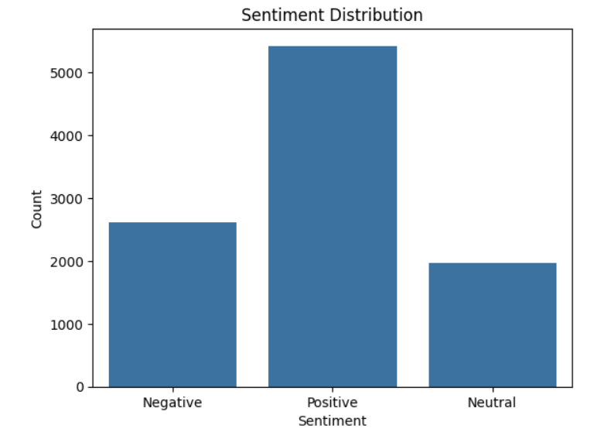
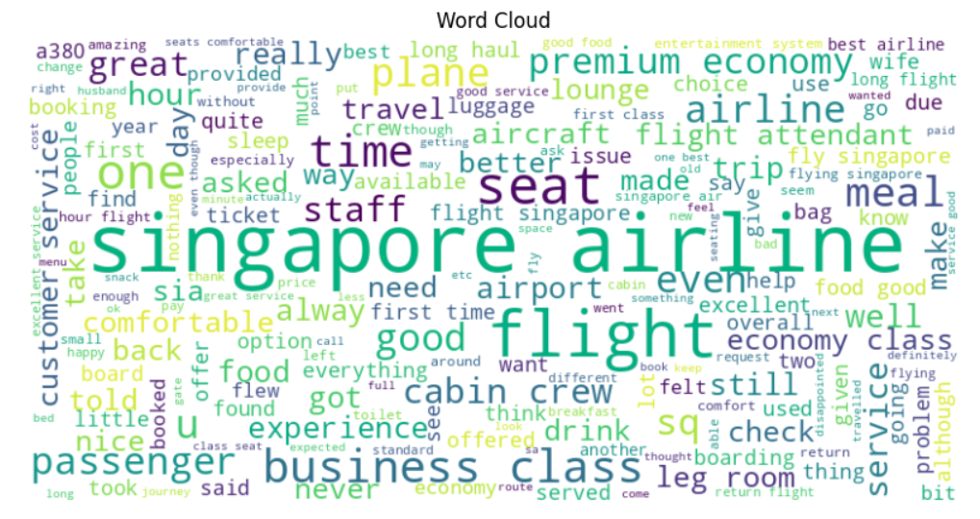
RESULTS
Demo Link
3/21/2024 Annual Review

